Slide 1
KLASA TECHNICAL TEST ANSWERS
Created By:
Dody Harianto
Universitas Bina Nusantara

Slide 2
A. PROBLEM SOLVING SKILL

Slide 3
Several Causes of Getting Low Grades
Does not understand basic concepts
Struggles to follow school pace
Lack of practice
Does not have clear guides (mentor, courses, etc.)
Has not found the perfect learning style/way.

Slide 4
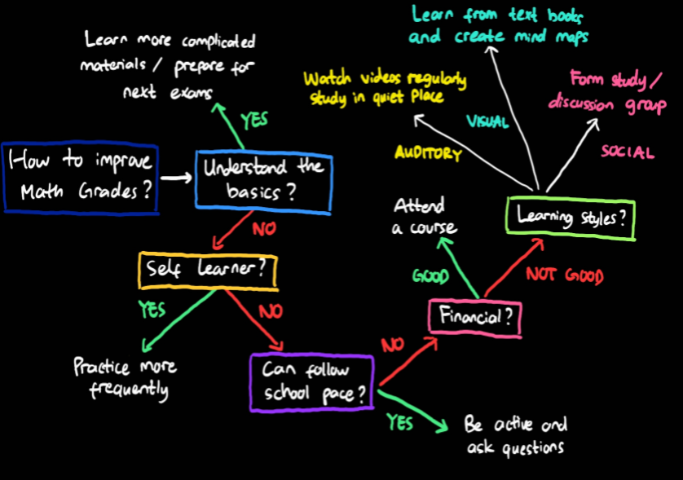
Logic Tree

Slide 5
Explanation
The most important part of learning math is to really understand the basic concepts.
If he is not used to learn by himself, he may ask questions in class to understand math better.
If he struggles to follow pace, attending a course may be a solution. But if not possible, he can get to know his learning style and practice to improve his grades.

Slide 6

B. BASIC STATISTICS
Tool:
Visit this link to view full notebook:
https://www.kaggle.com/dodyharianto/basic-statistics

Slide 7
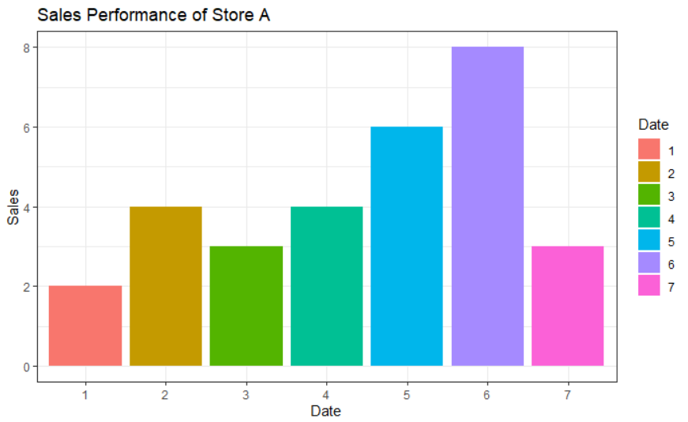
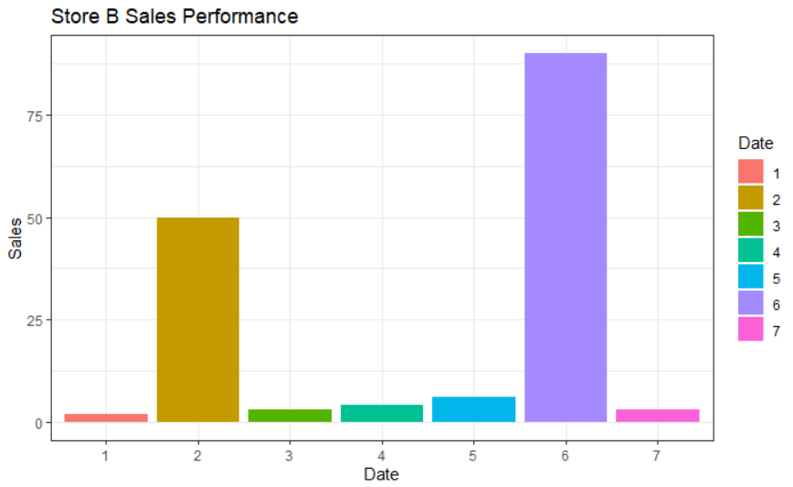
BAR CHART
A
B

Slide 8
Insights
In both stores, Saturday is the day with most sales, meanwhile Monday is the day with least sales.
Total sales of Store A is 30, which is nowhere near the total sales of Store B, which is 153 (in a week).
The variability of Store B number of sales is much higher than Store A’s. The number of sales of Store B increase drastically in 2nd and 6th day.

Slide 9
Summary Statistics
STORE A
Measure of Center:
Mean: 4.29
Median: 4
Measure of Variability:
Variance: 4.24
Std. Deviation: 2.06
STORE B
Measure of Center:
Mean: 22.57
Median: 4
Measure of Variability:
Variance: 1184.62
Std. Deviation: 34.42

Slide 10
What is the most suitable value to describe total daily sales for each store?
It depends on the sales distribution
of each store. We need to check for normality.

Slide 11
Normality Test
There are several ways that we can use to check whether a distribution follows the normal distribution:
Mean and Median Comparison
Histogram
Density Plot
Q-Q Plot (Quantile – Quantile Plot)
Box Plot
Shapiro-Wilk’s Test

Slide 12
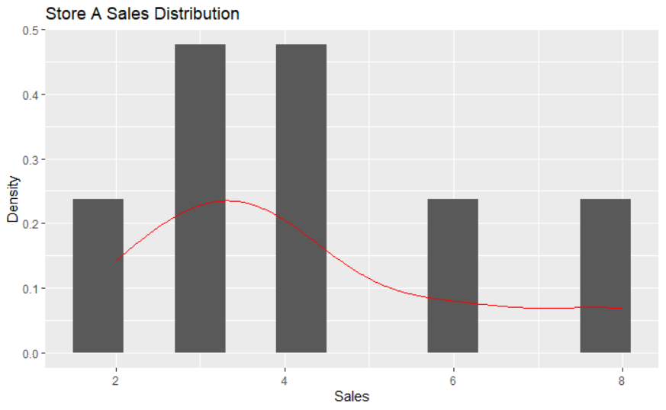
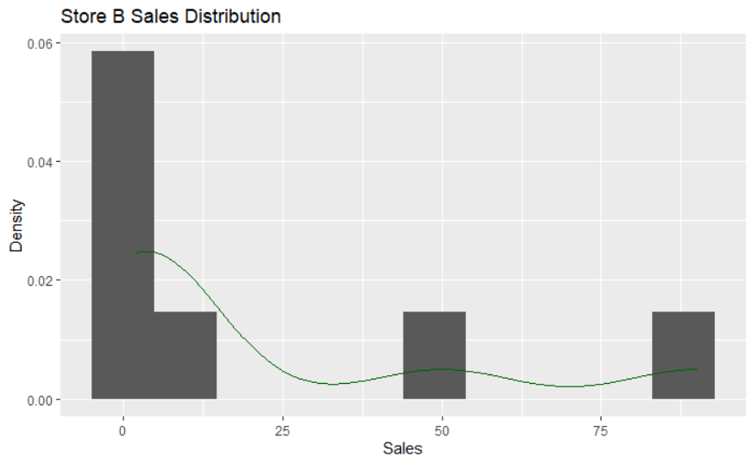
HISTOGRAM
A
B

Slide 13
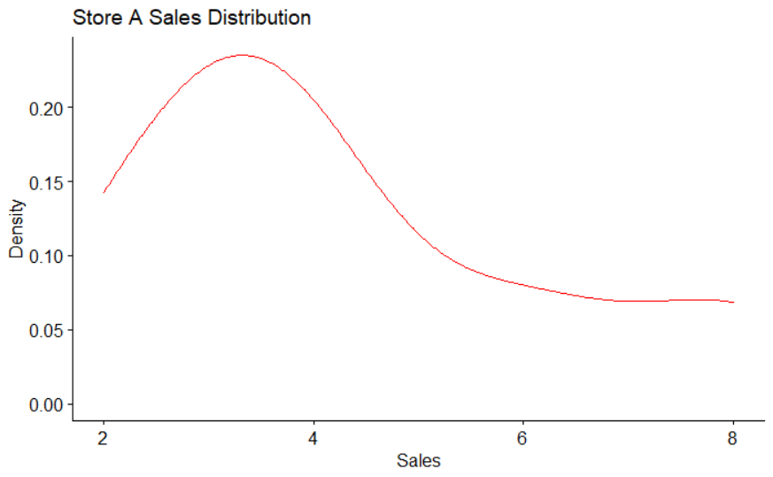
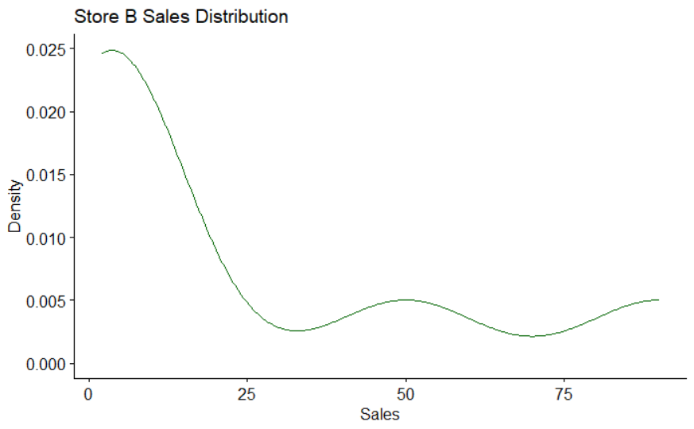
DENSITY PLOT
A
B

Slide 14
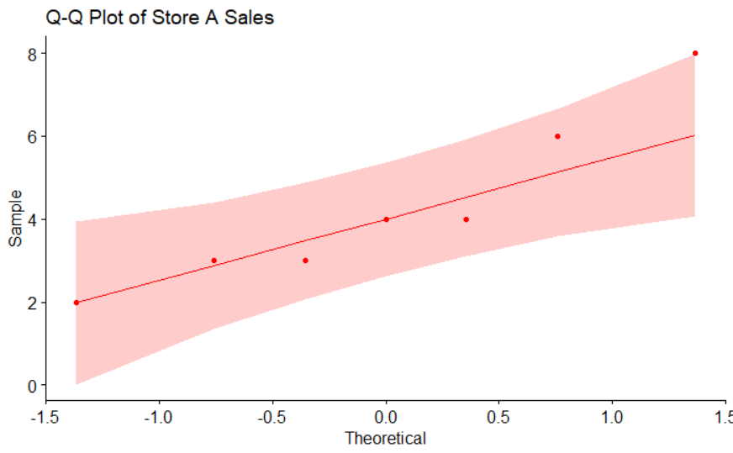
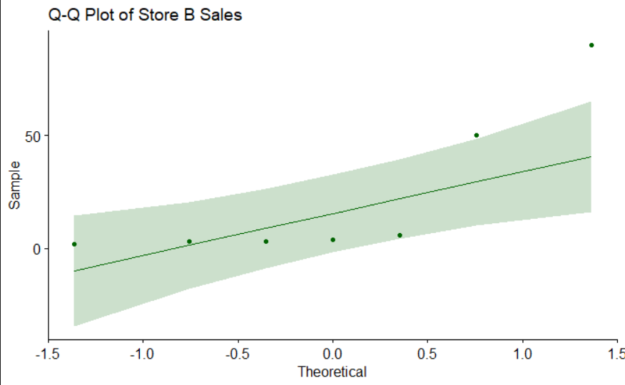
QQ PLOT
A
B

Slide 15
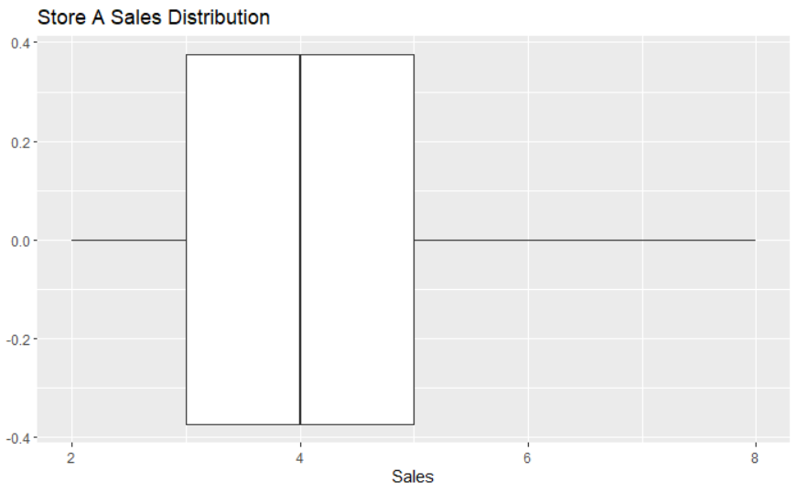
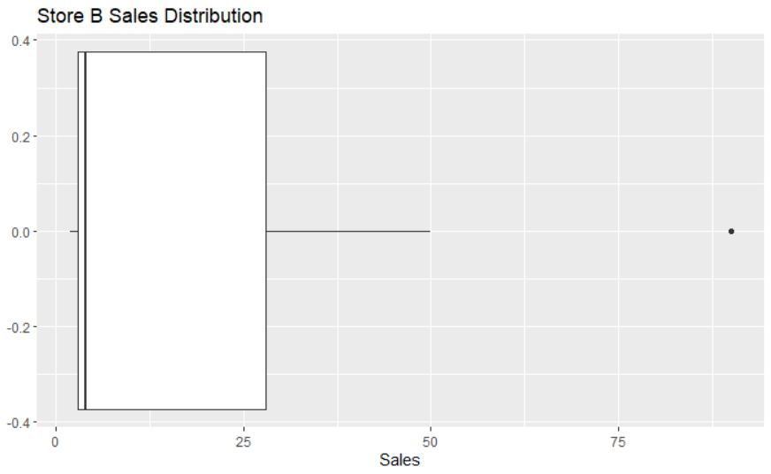
BOX PLOT
A
B
Outlier

Slide 16
Shapiro-Wilk’s Hypothesis Test
Hypotheses:
H0: The sales distribution follows the normal distribution
H1: The sales distribution does not follow the normal distribution
Decision:
If p-value < 0.05 (significance level), we reject the null hypothesis (H0).

Slide 17
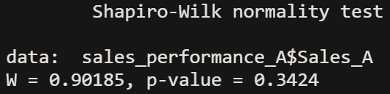
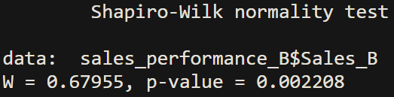
Shapiro-Wilk’s Test For Each Store
STORE A
The p-value > 0.05, then fail to reject H0.
Store A sales somewhat follows the normal distribution.
STORE B
The p-value < 0.05, then reject H0.
Store B sales distribution does not follow the normal distribution.

Slide 18
What is the most suitable value to describe total daily sales for each store?
For Store A, the most suitable value to describe the total daily sales is either the mean (4.29) or median (4) since they are quite close (about 4 days). When the distribution is normal, both mean and median are good representative for the data.
For Store B, median (4) is the most suitable value to describe the total sales in a day. Since it is a robust estimate if there is an outlier in the data. Mean (22.57) is not a good measure since it is easily affected by outlier because it involves all data points in its formula.

Slide 19
C. BASIC SQL

Slide 20
APPROACH (METHOD #1)
Select the first row from the table
Order by the published timestamp to get the most recent information.
Do the same for both of the hospital names.
Notes:
I changed the table name to tracking_rs because the table name may not contain symbols.

Slide 21
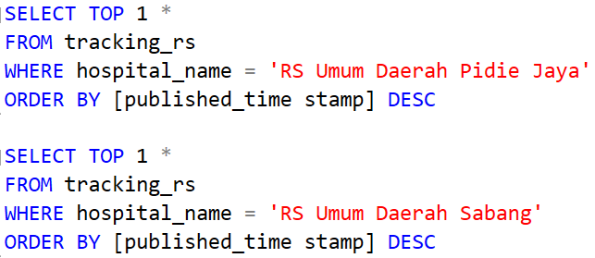
QUERY (METHOD #1)
SQL Version Used: SQL Server

Slide 22
APPROACH (METHOD #2)
Select all columns in the table, but use the MAX( ) aggregate function for the timestamp to get the latest information.
Group the table by the hospital names to get exactly one observation (rows) for each hospital.

Slide 23
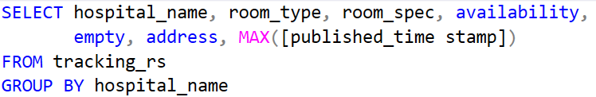
QUERY (METHOD #2)
(This is the solution that I know but it may not work in several versions of SQL)

Slide 24
THANK YOU!
Questions? Email: hariantodody14@gmail.com

